Slide 1
We learned some interesting things about Spark and how it interacts with EMR…

Slide 2
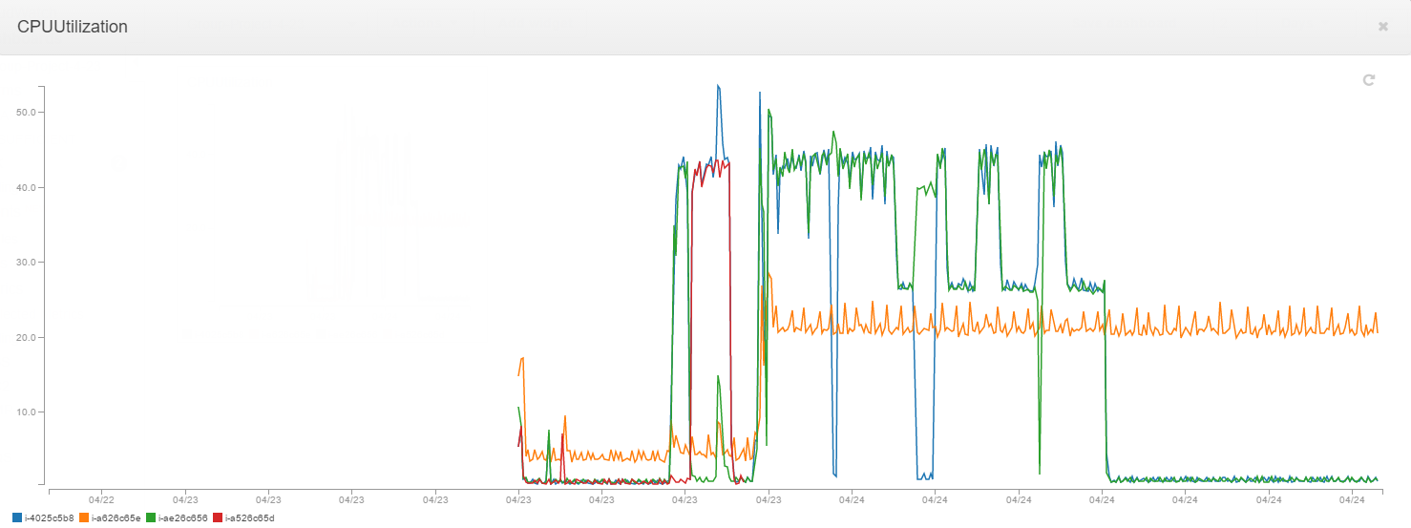
EMR 4.3
Nodes barely break 50% CPU utilization. Master node not pictured

Slide 3
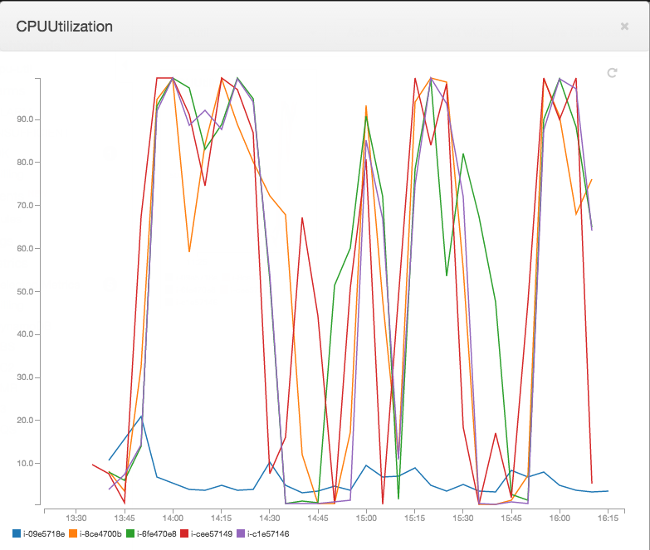
EMR 4.4
Most nodes over 90% CPU utilization most of the time. Master node shown in blue

